Slide 1
Data Structures Chapter 2-4
Performance Analysis
Big-O Notation
Big-O Properties
Growth Rates

Slide 2
Big-O 표기법이 무엇인지 알고 직접 계산할 수 있다

Slide 3
그러므로 나의 사랑하는 자들아 너희가 나 있을 때 뿐 아니라 더욱 지금 나 없을 때에도 항상 복종하여 두렵고 떨림으로 너희 구원을 이루라 (Continue to work out your salvation with fear and trembling.) 빌2:12
나는 인애를 원하고 제사를 원하지 아니하며 번제보다 하나님을 아는 것을 원하노라 (호6:6)
하나님은 모든 사람이 구원을 받으며 진리를 아는데에 이르기를 원하시느니라 (딤전2:4)
그런즉 너희가 먹든지 마시든지 무엇을 하든지 다 하나님의 영광을 위하여 하라 (고전10:31)

Slide 4
Agenda
Big-O Notation
Asymptotic Analysis (점근적 분석)
Big-O Properties
Calculating Big-O

Slide 5
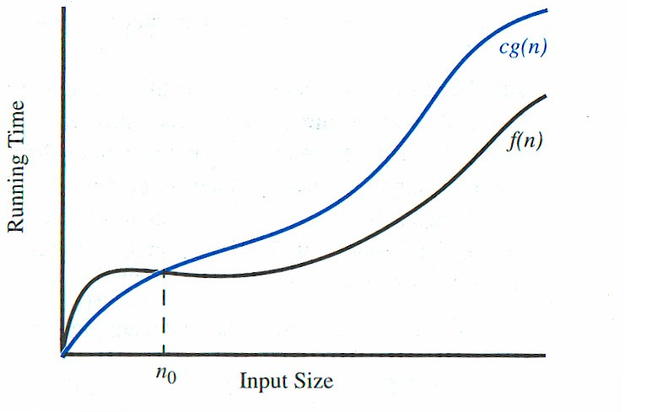
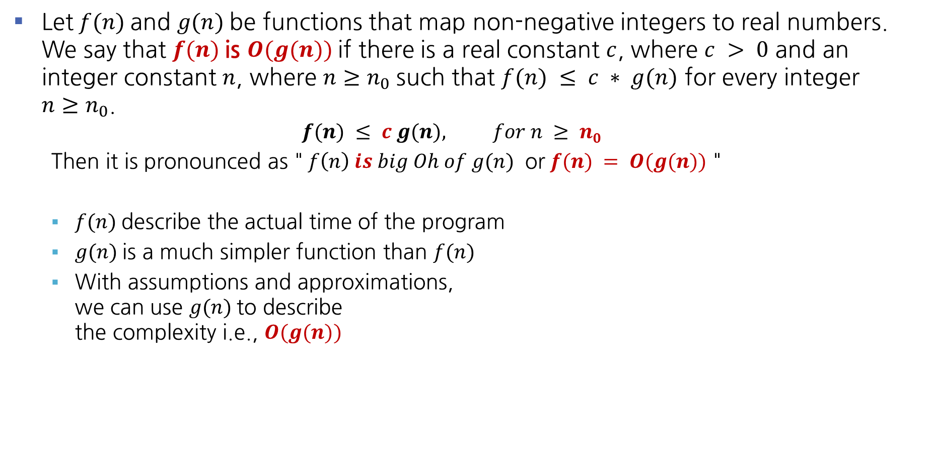
3 Big-O Definition
Let$f(n)$and $g(n)$be functions that map non-negative integers to real numbers. We say that $f(n)$is $O(g(n))$if there is a real constant $c$, where $c > 0$ and an integer constant $n$, where $n≥n_{0}$such that $f(n) ≤ c ∗ g(n)$ for every integer ${n≥n}_{0}$.
$$f(n) ≤ c g(n), for n ≥ n0$$
Then it is pronounced as "$f\left(n\right) is big Oh of g(n)$ or$f(n) = O(g(n))$ "
$f(n)$describe the actual time of the program
$g(n)$is a much simpler function than $f(n)$
With assumptions and approximations, we can use $g(n)$to describe the complexity i.e., $O(g(n))$
Big-O Notation is a mathematical formula that best
describes an algorithm’s performance.

Slide 6

3 Big-O Notation
We use Big-O notation (capital letter O) to specify the order of complexity of an algorithm.
$e.g., O\left(n^{2}\right), O\left(n^{3}\right), O\left(n \right)$
If a problem of size n requires time that is directly proportional to n, the problem is $O\left(n\right)$– that is, order n.
If the time requirement is directly proportional to $n^{2}$, the problem is O($n^{2}$), etc.

Slide 7
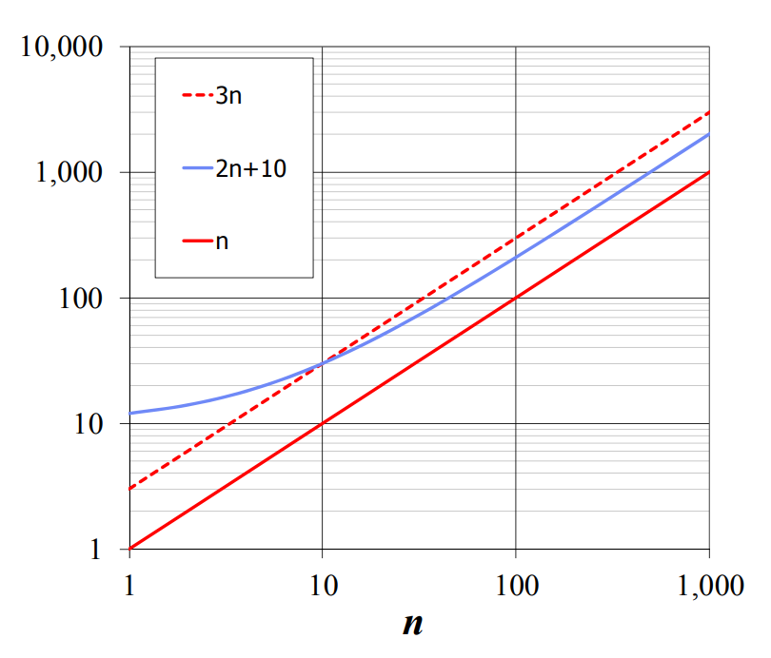

3 Big-O Examples
Given functions 𝑓(𝑛) and 𝑔(𝑛), we say that 𝑓(𝑛) is 𝑂(𝑔(𝑛)) if there are positive constants, 𝑐, and $n_{0}$ such that 𝑓(𝑛) ≤ 𝑐 ∗ 𝑔(𝑛) for every integer ${n≥n}_{0}$.
Example: T(n) = 2n + 10 T(n) is O(n)
Question:

Slide 8

3 Big-O Examples
Given functions 𝑓(𝑛) and 𝑔(𝑛), we say that 𝑓(𝑛) is 𝑂(𝑔(𝑛)) if there are positive constants, 𝑐, and $n_{0}$ such that 𝑓(𝑛) ≤ 𝑐 ∗ 𝑔(𝑛) for every integer ${n≥n}_{0}$.
Example: T(n) = 2n + 10 T(n) is O(n)
Question:
n₀
c
g(n)
𝑓(𝑛) ≤ 𝑐 ∗ 𝑔(𝑛)
𝑓(𝑛) is 𝑂(𝑔(𝑛))

Slide 9

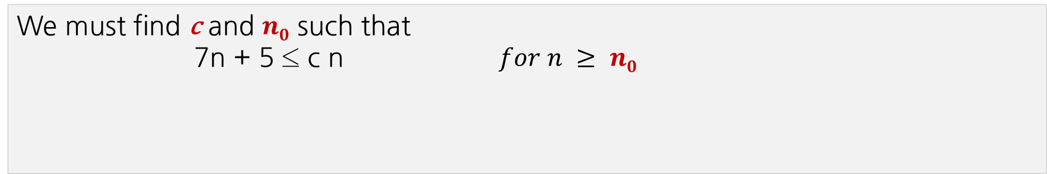

3 Big-O Examples
Find c and $n0$ to justify that the function $7n + 5$is $O(n)$.
We must find c and $n0$ such that
7n + 5 ≤ c n $for n ≥ n0$
c g(n)
running
time
$$upper$$
$$bound$$
f(n)
n₀
input size n

Slide 10
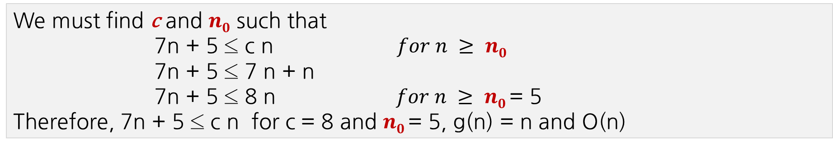
3 Big-O Examples
Find c and $n0$ to justify that the function $7n + 5$is $O(n)$.
We must find c and $n0$ such that
7n + 5 ≤ c n $for n ≥ n0$
7n + 5 ≤ 7 n + n
7n + 5 ≤ 8 n $for n ≥ n0$= 5
Therefore, 7n + 5 ≤ c n for c = 8 and $n0$= 5, g(n) = n and O(n)
c g(n)
running
time
$$upper$$
$$bound$$
f(n)
n₀
input size n

Slide 11
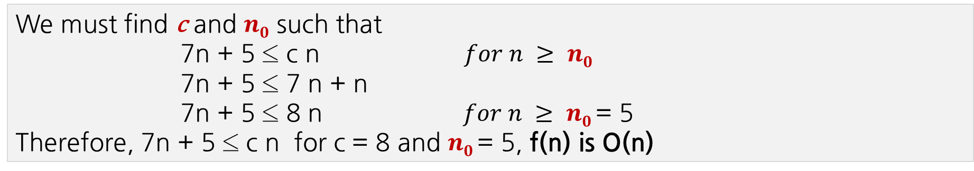
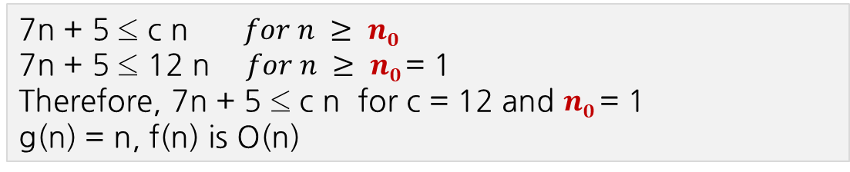
3 Big-O Examples
Find c and $n0$ to justify that the function $7n + 5$is $O(n)$.
We must find c and $n0$ such that
7n + 5 ≤ c n $for n ≥ n0$
7n + 5 ≤ 7 n + n
7n + 5 ≤ 8 n $for n ≥ n0$= 5
Therefore, 7n + 5 ≤ c n for c = 8 and $n0$= 5, f(n) is O(n)
c g(n)
running
time
$$upper$$
$$bound$$
7n + 5 ≤ c n $for n ≥ n0$
7n + 5 ≤ 12 n $for n ≥ n0$= 1
Therefore, 7n + 5 ≤ c n for c = 12 and $n0$= 1
g(n) = n, f(n) is O(n)
f(n)
n₀
input size n

Slide 12
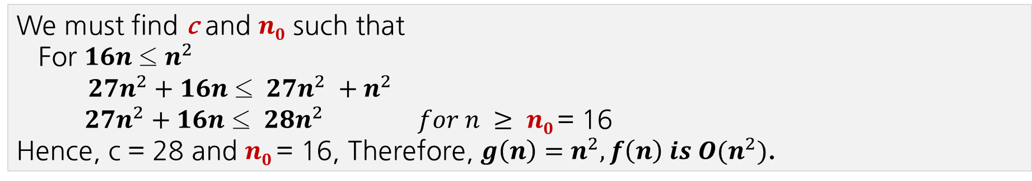

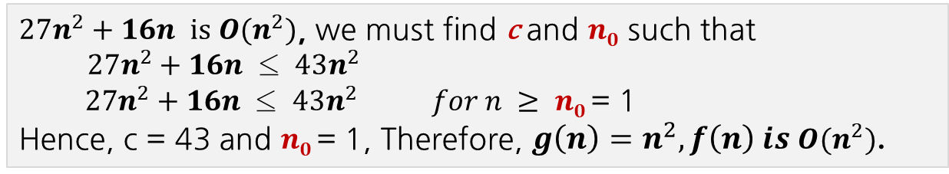
3 Big-O Examples
Find c and $n0$ to justify that the function $f\left(n\right)=27n^{2}+16n$is $O(n^{2})$.
We must find c and $n0$ such that
For $16n$ ≤ $n^{2}$
${27n}^{2}+16n$ ≤ ${27n}^{2} +n^{2}$
${27n}^{2}+16n$ ≤ ${28n}^{2} for n ≥ n0$= 16
Hence, c = 28 and $n0$= 16, Therefore, $g\left(n\right)=n^{2}, f\left(n\right) is O(n^{2})$.
c g(n)
running
time
$$upper$$
$$bound$$
$27n^{2}+16n is O(n^{2})$, we must find c and $n0$ such that
$27n^{2}+16n$ ≤ $43n^{2}$
$27n^{2}+16n$ ≤ $43n^{2} for n ≥ n0$= 1
Hence, c = 43 and $n0$= 1, Therefore, $g\left(n\right)=n^{2}, f\left(n\right) is O(n^{2})$.
f(n)
n₀
input size n

Slide 13
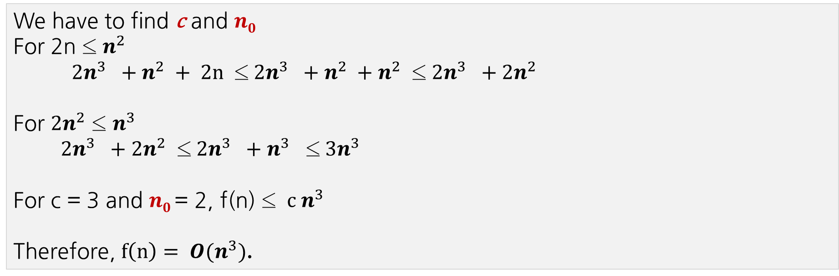

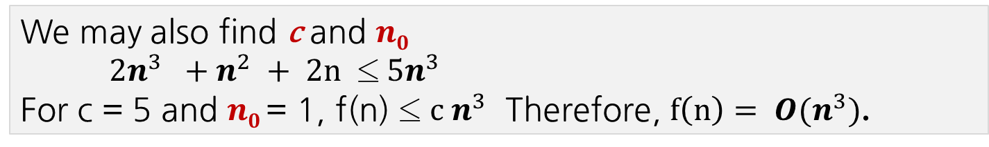
3 Big-O Examples
Find c and $n0$ to justify $2n^{3}+n^{2}+2n$is $O(n^{3})$.
We have to find c and $n0$
For 2n ≤ $n^{2}$
$2n^{3} +n^{2} + 2n$ ≤$2n^{3} +n^{2} +n^{2}$ ≤$2n^{3} +{2n}^{2}$
For ${2n}^{2}$ ≤ $n^{3}$
$2n^{3} +{2n}^{2}$ ≤$2n^{3} +n^{3}$ ≤$3n^{3}$
For c = 3 and $n0$= 2, f(n) ≤ $c n^{3}$
Therefore, $f\left(n\right)= O(n^{3})$.
We may also find c and $n0$
$2n^{3} +n^{2} + 2n$ ≤$5n^{3}$
For c = 5 and $n0$= 1, f(n) ≤ $c n^{3}$ Therefore, $f\left(n\right)= O(n^{3})$.

Slide 14
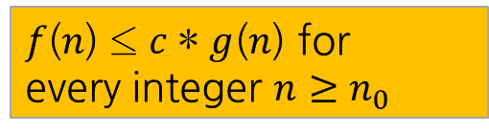

3 Big-O Examples
Suppose an algorithm requires
T(n) = 7n-2 operations to solve a problem of size n
T(n) = $n^{2}$ - 3 * n + 10 operations to solve a problem of size n
T(n) = 3n³ + 20n² + 5 operations to solve a problem of size n
𝑓(𝑛) ≤ 𝑐 ∗ 𝑔(𝑛) for every integer ${n≥n}_{0}$
7n-2 ≤ 7 * n for all n₀ ≥ 1
i.e., c = 7, n₀ = 1
O(n)
n² - 3 * n + 10 < 3 * n² for all n₀ ≥ 2
i.e., c = 3, n₀ = 2
O(n²)
3n³ + 20n² + 5 < 4 * n³ for all n₀ ≥ 21
i.e., c = 4, n₀ = 21
O(n³)

Slide 15

3 Big-O Examples
$3n+2 =O(n) since 3n+2≤4n for n≥2$
$3n+3 =O(n) since 3n+3≤4n for n ≥3$
$100n+6=O(n) since 100n + 6 ≤101n for n≥6$
$10n2+4n+2 = O(n2) since 10n2+4n+2 ≤11n2 for n≥5,$
$6∗2n+n2 = O(2^{n}) since 6∗2n+n2 ≤ 7∗2n for n≥4$
$3n+3 =O(n2) since 3n+3≤3n2 for n≥2$
$10n2+4n+2 =O(n4) since 10n2+4n+2 ≤10n4 for n≥2,$
$3n+2≠O(1) as 3n + 2 is not≤c for any c and all n, n ≥ n0.$
$10n2+4n+2 ≠O(n)$

Slide 16
Summary
Big-O Notation is a mathematical formula that best describes an algorithm’s performance.
Big-O notation is often called the asymptotic notation (점근적 표기법) since it uses so-called the asymptotic analysis (점근적 분석) approach.
Normally we assume worst-case analysis, unless told otherwise.
In some cases, it may need to consider the best, worst and/or average performance of an algorithm

Slide 17
Big-O(빅 오)은 알고리즘의 수행능력을 잘 나타내는 수학적인 표기법이다
Big-O를 계산할 때 주어진 함수들에서 가장 근접한 함수를 찾는 것이 좋다

Slide 18
수고했습니다
곧 다음 시간에
다시 뵙겠습니다

